Slide 1
Basic MLA Format
English, History and other Humanities

Slide 2
Research for Academic Purposes
The basis of research is to READ and make notes.
You are learning new information or you are confirming information that is NOT general knowledge.
Since you are learning new things, when you report them to the teacher or the class, you need to give credit to the creator of the information -- the author or photographer, or videographer, or designer, or...
If you don't give credit, it is

Slide 3
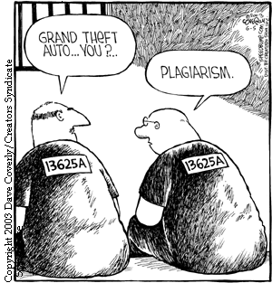
Why Use MLA?
In English, History and other Humanities, we use the Modern Language Association’s method of cataloguing our research sources.
You must give credit to ALL facts, ideas and images that you did not create on your own. Yup, ALL FACTS, IDEAS AND IMAGES.
You must give credit to your research in two places:
As an embedded (in-text) citation
On a Works Cited page
(“Are we missing the mark?”)

Slide 4
So how do I do that? Example with an Author:
In-text Example:
Teens are congratulated for taking the initiative: "Students with intrinsic motivation are more likely to succeed in both academic and social situations" (Maxwell 152).
Corresponding Works Cited Entry:
Maxwell, Gillian. Putting the Pieces Together. Whitby: Hawkstone Publishing, Ltd., 2014. Print.

Slide 5
Example with Unknown Author:
In-text Example:
It is true that we are fooled by fiction; it is lies, “Yes, carefully constructed lies that suck you in and make you care deeply about characters and settings and plot. Lies that inspire you and spark your imagination. Lies that transport you out of your own life and allow you to relish the lives of others. Lies that devastate you as you turn the final page and must end the story” (“How Books have Disappointed Me”).
Fiction is comprised of lies that mimic real life so that you can discover more about yourself as an individual, a member of society and as a human (Maxwell).
Corresponding Works Cited Entry:
“How Books have Disappointed Me.” Hawk Blog. Henry Street High School. 27 Feb. 2014. Web. 22 Apr. 2014.

Slide 6
So, when I’m researching, what should I do?
You need to create the citation WHILE YOU’RE RESEARCHING AND MAKING NOTES!
Follow the Quick Guides from the school tutorials page
Use Word’s Citation tools or use Son of Citation Machine
Steps to follow:
Open a Word Document
Create the citation at the top of the page
Save the Word Document with a title that makes sense
Make jot notes on the page, making sure that you put the page number (if there is one) after the note
Make sure you use “ “ if you cut and paste the information to Word
LET’S TRY THAT!

Slide 7
So now to turn that into an Essay or Report…
You will need to organize your material according to the structure your teacher chooses:
Essay (formal or informal)
Essay/Report with Headings
Make sure you follow the basic MLA formatting for Word Documents.

Slide 8
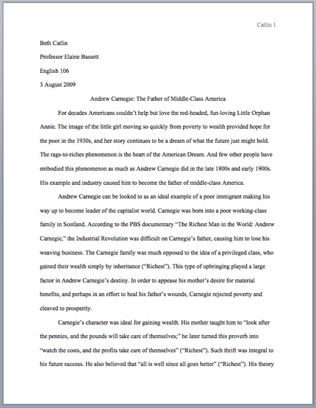
Basic MLA Format
No title page
Double space everything
In the upper left corner of the 1st page, list your
name, your instructor's name, the course, and date
Center the paper title (use standard caps but no
underlining, italics, quote, or bold)
Create a header in the upper right corner at half
inch from the top and one inch from the right of the
page (include your last name and page number)
(“Formatting the First Page of your Paper”)

Slide 9
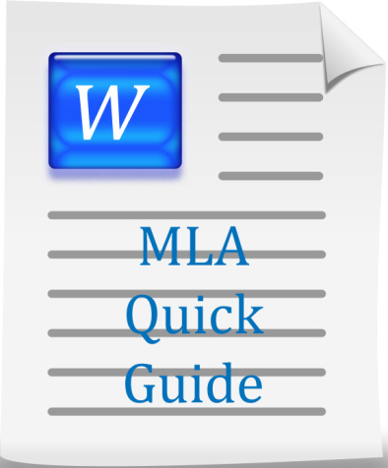
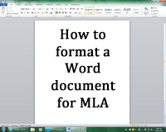
Wait! Too much information!
You could watch the video tutorial on the Henry Library Commons Website
While you’re there, check out the other useful resources:

Slide 10
What about Headings?
Numbered (all flush left with no underlining, bold, or italics):
Unnumbered (by level):
1. Soil Conservation
1.1 Erosion
1.2 Terracing
2. Water Conservation
3. Energy Conservation
Level 1 Heading: bold, flush left
Level 2 Heading: italics, flush left
Level 3 Heading: centered, bold
Level 4 Heading: centered, italics
Level 5 Heading: underlined, flush left

Slide 11
Questions?
If you have any questions, be sure to check out the Tutorials Page at the Henry Street Library Commons Website.
Or you can ask your teacher or Ms. Brown or Ms. Maxwell

Slide 12
Works Cited
“Are We Missing the Mark?.” Plagiarism. N.p., n.d. Web. 15 Apr. 2014.
“Formatting the First Page of your Paper.” The Purdue OWL. Purdue U Writing Lab, 2010. Web. 22 Apr. 2014.

